Slide 1
Periphery Handling PCB
Rappai Soma
ONQZ95

Slide 2
About
Starting idea
My Initial Plans
Difiiculties
My Goal
Progress

Slide 3
Starting Idea
For BKV
GPS
GSM
Microphone
Money

Slide 4
My Initial Plans
One PCB
Six Peripferies
Own GPS
Wireless

Slide 5
Difficulties
No GSM -> No wireless
The Programming
Size

Slide 6
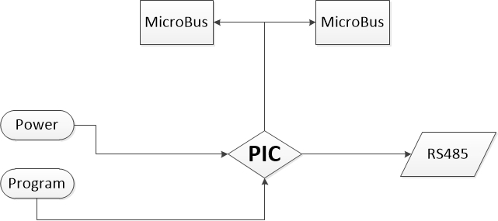
My Goal
Simple use
Precise(50m)
Visualized in Computer

Slide 7
Progress
Board
GPS
Program
Other Electrical Parts(Resistors, Capacitors,ICs)

Slide 8
Thank You for Your Attention

